Slide 1
Introduction to Pesticides
Marion Local High School
Matt Elsass

Slide 2
What are Pesticides?
Notes:
🍐 This is a Pear Deck Text Slide
🍐 To edit the type of question, go back to the "Ask Students a Question" in the Pear Deck sidebar.

Slide 3
Pesticides
Pesticides are chemical compounds, either organic or inorganic in origin, that are used to manage pest populations.

Slide 4
We previously discussed some different pests. List them.

Slide 5
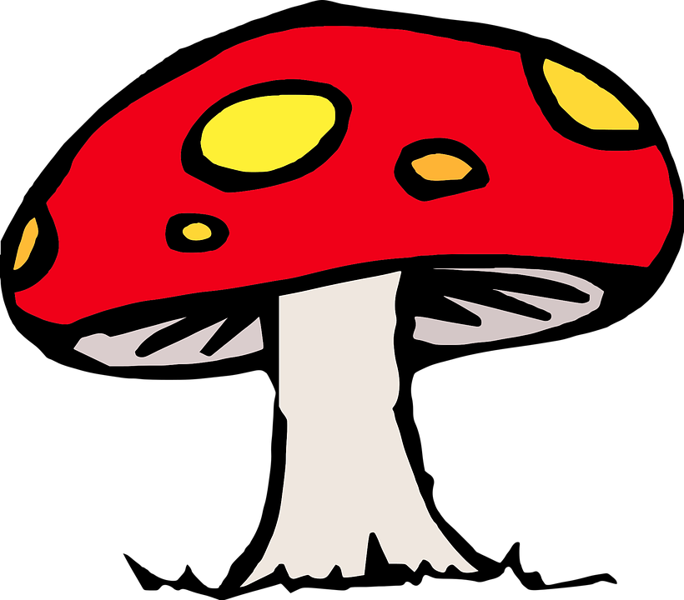
The big three
Insecticides = Bugs
Herbicides = Plants
Fungicides = Fungi

Slide 6
As part of a pest management system, pesticides should be considered last. If other means are available, you should use those first.

Slide 7
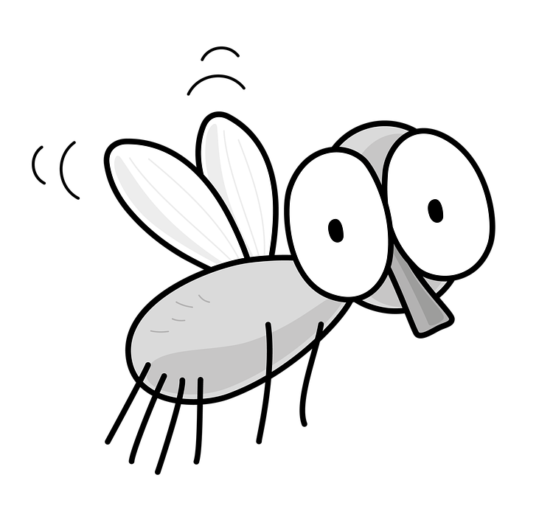
How do they work?
Pesticides typically work by disrupting certain aspects of a pest biology. This can lead to death, or just render the pest ineffective.
Example: If an insect only causes crop damage an adult, keeping it in the larva stage will keep it from damaging crop and reproducing.

Slide 8
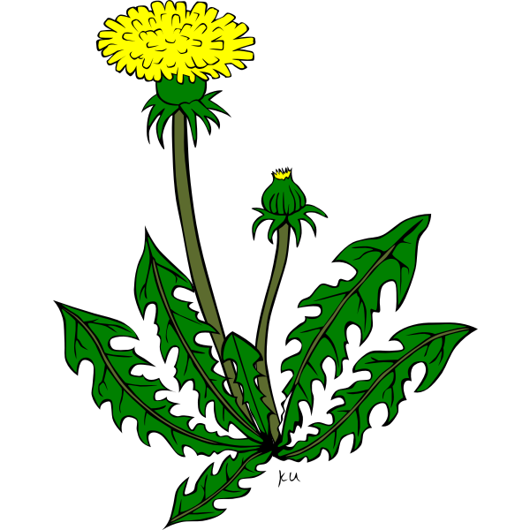
Modes of Action

Slide 9
Mode of Action
This refers to how a pesticide works. We will focus on insecticide MoA’s for this presentation.
Main action groups include:
Compounds that affect the nervous system.
Compounds that breakdown digestive walls.
Compounds that inhibit the organism's ability to metabolize energy.
Compounds that mimic hormones.
Unknown MoA
These are split into further classifications. For example, the nervous system can be hijacked in different ways.

Slide 10
Browse the IRAC website. Find MoA groups in different colors and click on the information icon to see how it works.
Notes:
🍐 This is a Pear Deck Web Slide.
🍐 To edit the type of question, go back to the "Ask Students a Question" in the Pear Deck sidebar.

Slide 11
Type 2 examples of MoA’s from the website in this prompt. Group # and how it works.
Notes:
🍐 This is a Pear Deck Text Slide
🍐 To edit the type of question, go back to the "Ask Students a Question" in the Pear Deck sidebar.

Slide 12
Why might the MoA be important?
Notes:
🍐 This is a Pear Deck Text Slide
🍐 To edit the type of question, go back to the "Ask Students a Question" in the Pear Deck sidebar.

Slide 13
Why is that important?
To slow that amount of time it takes for pests to form resistance to compounds, use pesticides with varying modes of action.
Eventually, pests will develop resistance. Glyphosate (Roundup), for example, has been used heavily by producers for years almost exclusively, and many weeds have developed resistance.

Slide 14
Safety

Slide 15
Safe Handling
Be sure to carefully read the safety information on the label. Depending on the mode of action, pesticides can have varying toxicity to mammals. (YOU)
In general here is some common PPE:
Safety glasses or a respirator
Pants and long sleeve shirts or zip up coveralls.
Close toes boots
Rubber gloves

Slide 16
Pesticides can have varying health effects.
Acute Health Effect: Symptoms show up shortly after exposure.
Chronic Health Effect: Symptoms persist over time.
Inhalation, contact, or ingestion are ways that you can be exposed to pesticides.

Slide 17
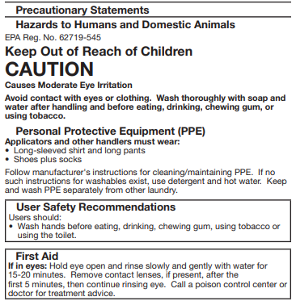
What are symptoms of this insecticide?
Notes:
🍐 This is a Pear Deck Text Slide
🍐 To edit the type of question, go back to the "Ask Students a Question" in the Pear Deck sidebar.

Slide 18
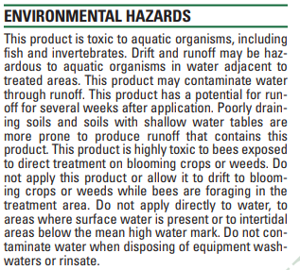
What organisms are possibly affected by this incesticide?
Notes:
🍐 This is a Pear Deck Text Slide
🍐 To edit the type of question, go back to the "Ask Students a Question" in the Pear Deck sidebar.

Slide 19
Synthetic vs. Organic
What does this mean? Is one better than the other?

Slide 20
Synthetic vs. Organic
Organic pesticides come from a natural source. They can be just as harmful to us and the environment as synthetic pesticides if used incorrectly!

Slide 21
Conventional vs. Organic
Read this opinion piece on conventional production vs. organic production. With a partner, discuss and summarize your initial stance on conventional vs. organic production in a paragraph. Reference the articles at least twice.
https://blogs.scientificamerican.com/science-sushi/httpblogsscientificamericancomscience-sushi20110718mythbusting-101-organic-farming-conventional-agriculture/

