Slide 1
Warm-up
Talk with the members of your group:
What is your most interesting food-related event?
What is the weirdest thing you have ever eaten?

Slide 2


Demystifying Food Labels and the "Can't Pronounce It - Don't Eat It" Concept
Zack Matesich
June 10, 2026

Slide 3
Roadmap
Food labels in context
What’s on it
  Required information on all food labels
  Nutrient/health claims
  Can you still eat it
What’s in it
  Nutritional facts label
  Reading an ingredients list
  Where it can go wrong

Slide 4
Food labels in context
A brief historical perspective

Slide 5
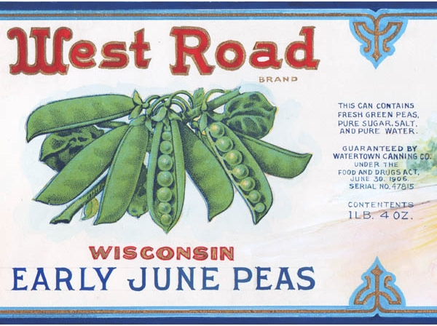
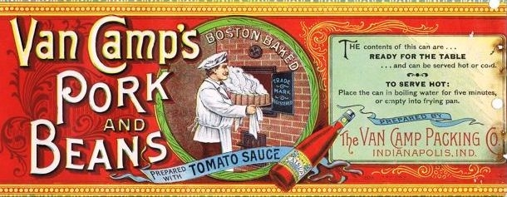
Historical Food Labels
Food labels were about advertising, not information
Occasionally they would have
ingredients listed
Wikimedia Commons

Slide 6
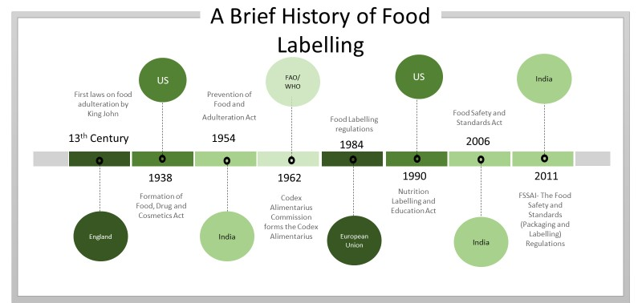
Development of Food Labels
Prior to modern era, food was often high adulterated
Publication of The Jungle by Sinclair in 1905
Crasto (2022)

Slide 7
What’s on it
Important content information for food labels

Slide 8
Getting to know your food
Look through the products on your table.
What information appears on every item?
What are some general trends you see?
What are some questions you have about the labels?
Is there any information you feel as though is missing?
Albrecht (2020)

Slide 9
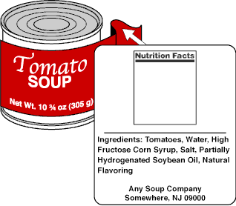
Food Labels
Required information
on all Food Labels:
  A statement of identity
  A net weight or contents statement
  An ingredient statement
  A statement that gives the name and place of business of the product’s manufacturer, packer, or distributor
  The Nutrition Facts label
A
E
b
C
D
Albrecht (2020)

Slide 10
Labeling
Strict guidelines on locations of information, type of units, language used, etc
Particularly for the statement of identity:
  Describes the product (if no common name exists)
  Common name of the food
Statement with name and place of business
  Requires ability to access complete address (either explicit or public directory)
Country of origin required by US Customs, not FDA
FDA (2013)

Slide 11
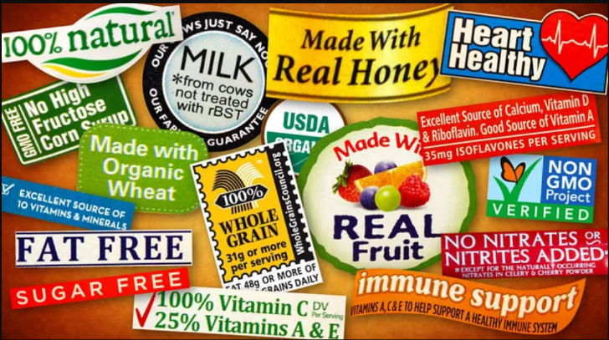
Product packaging
Lots of information can be present on a label:
But what does some/all of it mean?
Source: http://howtoeat.ca/how-food-labels-deceive-us-a-look-at-natural/

Slide 12
Nutrient content claims
Here’s the true meaning behind some of these claims
Calorie free | less than 5 calories per serving
Reduced calorie | at least 25% fewer calories than regular version
Low calorie | 40 calories or less per serving
Fat free | less than 0.5 grams fat per serving (trans or saturated)
Reduced fat | at least 25% less fat than regular version
Low fat | 3 grams or less of fat per serving
Sugar free | less than 5 calories per serving
Reduced sugar | at least 25% less sugar than regular version
No added sugar | no sugars added during processing or packing, including items containing sugar (eg juice or dry fruit)
Light/Lite | 1/3 fewer calories or 50% less fat than regular version
FDA (2013)

Slide 13
Claims that sound better than they are
Consider the labels that can be attached to eggs:
  Cage-free vs Free-range
What do these terms evoke in you?
Cage-Free: This term means that the hens are not kept in cages, but it doesn’t mean they’re clucking around in the fresh air and sunshine. They can be kept indoors, often in crowded conditions. (1 sq ft per chicken)
Free-Range: The birds aren’t kept in cages and have outdoor access, but they can still be raised in crowded conditions and the outdoor area can be tiny. (2 sq ft per chicken)

Slide 14
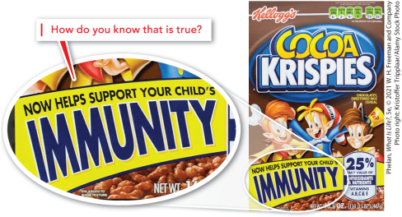
Making claims without support
Two claims in 2000’s by Kellogg’s regarding Frosted Mini-Wheats and Rise Krispies were unsubstantiated
Investigated by the FTC and subsequently barred from making further health claims
Phelan (2021)
Notes:
made false claims that its Frosted Mini-Wheats cereal was “clinically shown to improve kids’ attentiveness by nearly 20%.

Slide 15
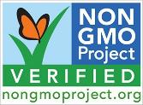
Other label claims
“GMO Free”
  Only 14 currently approved GMO crops/foods
    Alfalfa, Arctic Apple, Canola, Corn, Cotton, Eggplant, Papaya, Pink pineapple, Potato, Salmon (AquAdvantage), Soybean, Squash, Sugar Beet, Sugarcane
  However, use of GMO germ lines varies highly among crops
    Nearly all field corn is GMO, but sweet corn is rarely GMO
  More of the GMO concerns relate to growing regulations
  Sugar can “bypass” GMO labels due to being highly processed
  However, it doesn’t stop this label from being used:
  Look at the items at your table.
  Which ones are labelled non-GMO and
  are valid items for the label and which are not?
FDA (2013)
Notes:
Alfalfa: Grown primarily as animal feed, which means it indirectly affects dairy and meat products.
Apple: Non-browning Arctic apple varieties.
Canola: Used to produce canola oil.
Corn: Field corn is almost entirely GMO; sweet corn is rarely GMO, though a few varieties exist.
Cotton: Used for cottonseed oil and as livestock feed
.Eggplant: Certain insect-resistant varieties (not widely grown in the US, but available globally).Papaya: The majority of Hawaiian papayas are GMO to resist the ringspot virus.
Pineapple: Pink-flesh pineapple varieties (engineered to have higher levels of lycopene)
.Potato: Modified to resist bruising and reduce acrylamide when fried (such as Innate potatoes).
Salmon: The AquAdvantage genetically engineered salmon is the only approved GMO animal for human consumption.
Soybean: Over 94% of all soy grown in the US is GMO. Used for oil, tofu, lecithin, and feed.
Squash: Specific varieties of summer squash/zucchini are modified to resist viruses.
Sugar Beet: Nearly 99% of US sugar beets are GMO, making up more than half of the nation's refined sugar supply.
Sugarcane: Certain insect-resistant sugarcane varieties. [1, 2, 3, 4, 5]

Slide 16
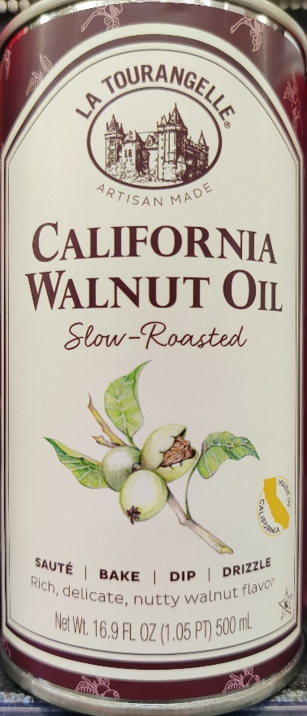
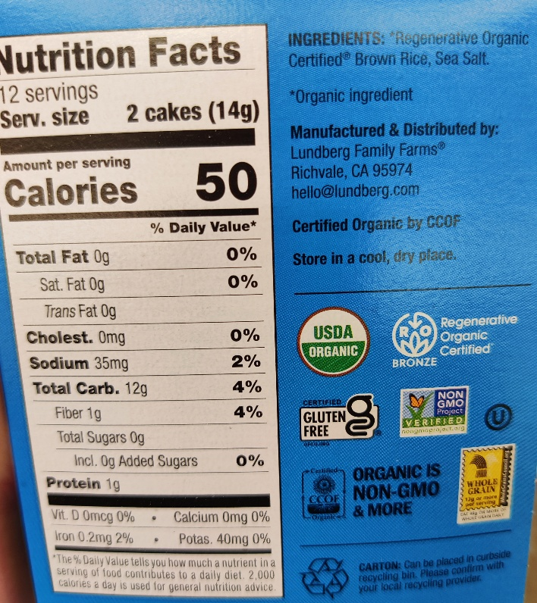
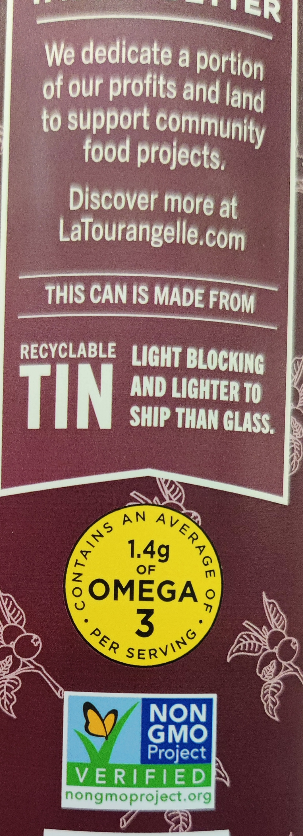
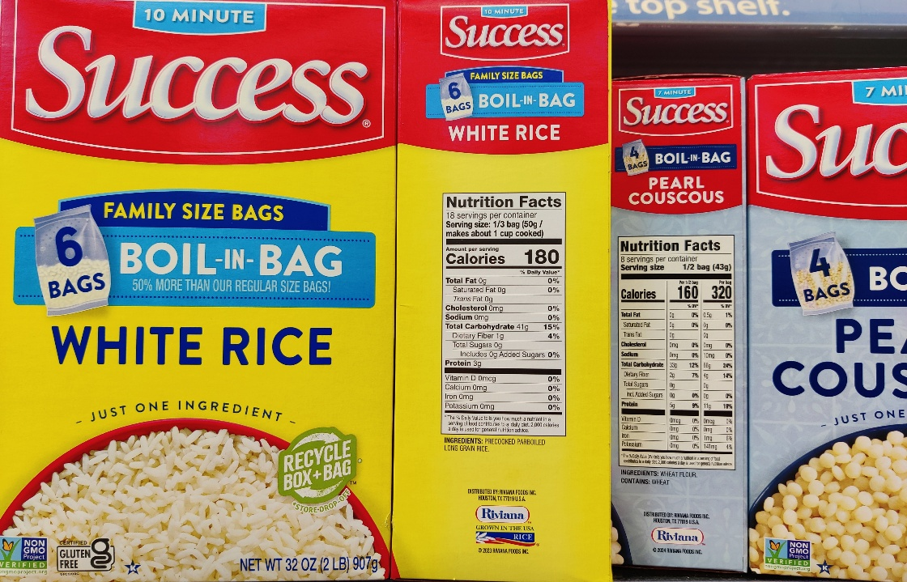
Other label claims
“GMO Free” with without GMO crops
  Remember: Alfalfa, Arctic Apple, Canola, Corn, Cotton, Eggplant, Papaya, Pink pineapple, Potato, Salmon (AquAdvantage), Soybean, Squash, Sugar Beet, Sugarcane
Image source: Photos by Zack Matesich
Notes:
Alfalfa: Grown primarily as animal feed, which means it indirectly affects dairy and meat products.
Apple: Non-browning Arctic apple varieties.
Canola: Used to produce canola oil.
Corn: Field corn is almost entirely GMO; sweet corn is rarely GMO, though a few varieties exist.
Cotton: Used for cottonseed oil and as livestock feed
.Eggplant: Certain insect-resistant varieties (not widely grown in the US, but available globally).Papaya: The majority of Hawaiian papayas are GMO to resist the ringspot virus.
Pineapple: Pink-flesh pineapple varieties (engineered to have higher levels of lycopene)
.Potato: Modified to resist bruising and reduce acrylamide when fried (such as Innate potatoes).
Salmon: The AquAdvantage genetically engineered salmon is the only approved GMO animal for human consumption.
Soybean: Over 94% of all soy grown in the US is GMO. Used for oil, tofu, lecithin, and feed.
Squash: Specific varieties of summer squash/zucchini are modified to resist viruses.
Sugar Beet: Nearly 99% of US sugar beets are GMO, making up more than half of the nation's refined sugar supply.
Sugarcane: Certain insect-resistant sugarcane varieties. [1, 2, 3, 4, 5]

Slide 17
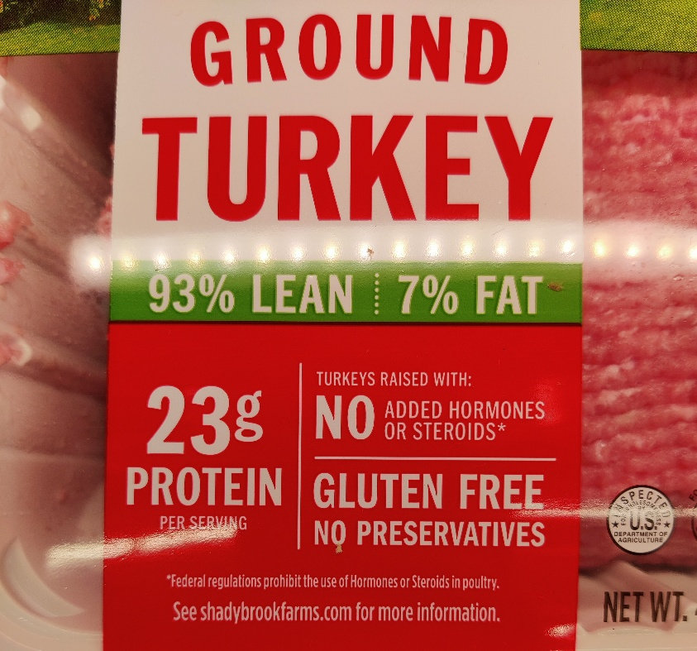
Other label claims
“No hormones added” or “raised without hormones”
  Anything that is or has been alive
  contains hormones, including plants!
  Per the USDA, added hormones
  aren’t allowed in pork or poultry.
Natural: Currently no definition
Healthy: Guidance by FDA is use of
term if one of these definitions are met:
Food not low in total fat but has fat
profile of mostly mono and polyunsaturated
fats OR contains at least 10% of the DV
of potassium or Vitamin D per amount
commonly consumed
Image source: Photos by Zack Matesich
FDA (2013)
Notes:
Alfalfa: Grown primarily as animal feed, which means it indirectly affects dairy and meat products.
Apple: Non-browning Arctic apple varieties.
Canola: Used to produce canola oil.
Corn: Field corn is almost entirely GMO; sweet corn is rarely GMO, though a few varieties exist.
Cotton: Used for cottonseed oil and as livestock feed
.Eggplant: Certain insect-resistant varieties (not widely grown in the US, but available globally).Papaya: The majority of Hawaiian papayas are GMO to resist the ringspot virus.
Pineapple: Pink-flesh pineapple varieties (engineered to have higher levels of lycopene)
.Potato: Modified to resist bruising and reduce acrylamide when fried (such as Innate potatoes).
Salmon: The AquAdvantage genetically engineered salmon is the only approved GMO animal for human consumption.
Soybean: Over 94% of all soy grown in the US is GMO. Used for oil, tofu, lecithin, and feed.
Squash: Specific varieties of summer squash/zucchini are modified to resist viruses.
Sugar Beet: Nearly 99% of US sugar beets are GMO, making up more than half of the nation's refined sugar supply.
Sugarcane: Certain insect-resistant sugarcane varieties. [1, 2, 3, 4, 5]

Slide 18
Health claims
Describe distinct relationship between a food, food component or dietary supplement AND a reduced risk for a specific disease or health condition.
Based on research, level determines classification
Ex of “Authorized”:
  “Diets low in sodium may reduce the risk of high blood pressure, a disease associated with many factors.”
  “Healthful diets with adequate folate may reduce a woman's risk of having a child with a brain or spinal cord birth defect.”
Ex of “Qualified”:
  “Scientific evidence suggests, but does not prove, that whole grains (three servings or 48 grams per day), as part of a low saturated fat, low cholesterol diet, may reduce the risk of diabetes type 2.”
Albrecht (2020)
Notes:
Alfalfa: Grown primarily as animal feed, which means it indirectly affects dairy and meat products.
Apple: Non-browning Arctic apple varieties.
Canola: Used to produce canola oil.
Corn: Field corn is almost entirely GMO; sweet corn is rarely GMO, though a few varieties exist.
Cotton: Used for cottonseed oil and as livestock feed
.Eggplant: Certain insect-resistant varieties (not widely grown in the US, but available globally).Papaya: The majority of Hawaiian papayas are GMO to resist the ringspot virus.
Pineapple: Pink-flesh pineapple varieties (engineered to have higher levels of lycopene)
.Potato: Modified to resist bruising and reduce acrylamide when fried (such as Innate potatoes).
Salmon: The AquAdvantage genetically engineered salmon is the only approved GMO animal for human consumption.
Soybean: Over 94% of all soy grown in the US is GMO. Used for oil, tofu, lecithin, and feed.
Squash: Specific varieties of summer squash/zucchini are modified to resist viruses.
Sugar Beet: Nearly 99% of US sugar beets are GMO, making up more than half of the nation's refined sugar supply.
Sugarcane: Certain insect-resistant sugarcane varieties. [1, 2, 3, 4, 5]

Slide 19
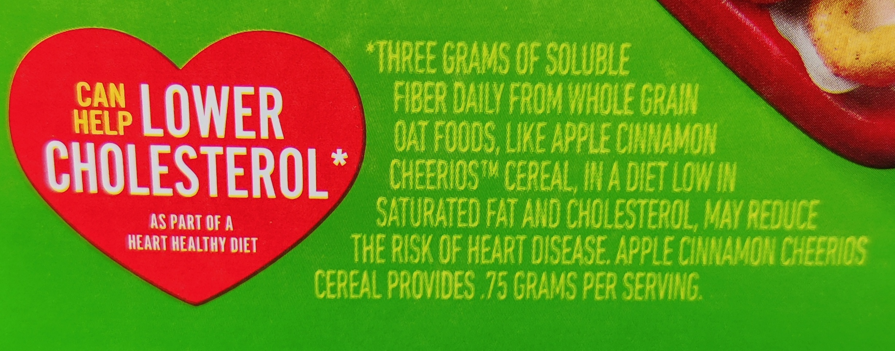
Health claims
Do any of your food have a health claim?
How would this claim be classified?
  Authorized – lack of disclaimer
Image source: Photos by Zack Matesich
Notes:
Alfalfa: Grown primarily as animal feed, which means it indirectly affects dairy and meat products.
Apple: Non-browning Arctic apple varieties.
Canola: Used to produce canola oil.
Corn: Field corn is almost entirely GMO; sweet corn is rarely GMO, though a few varieties exist.
Cotton: Used for cottonseed oil and as livestock feed
.Eggplant: Certain insect-resistant varieties (not widely grown in the US, but available globally).Papaya: The majority of Hawaiian papayas are GMO to resist the ringspot virus.
Pineapple: Pink-flesh pineapple varieties (engineered to have higher levels of lycopene)
.Potato: Modified to resist bruising and reduce acrylamide when fried (such as Innate potatoes).
Salmon: The AquAdvantage genetically engineered salmon is the only approved GMO animal for human consumption.
Soybean: Over 94% of all soy grown in the US is GMO. Used for oil, tofu, lecithin, and feed.
Squash: Specific varieties of summer squash/zucchini are modified to resist viruses.
Sugar Beet: Nearly 99% of US sugar beets are GMO, making up more than half of the nation's refined sugar supply.
Sugarcane: Certain insect-resistant sugarcane varieties. [1, 2, 3, 4, 5]

Slide 20
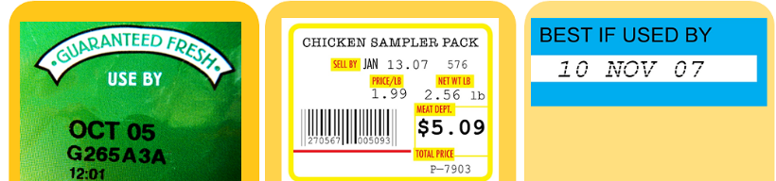
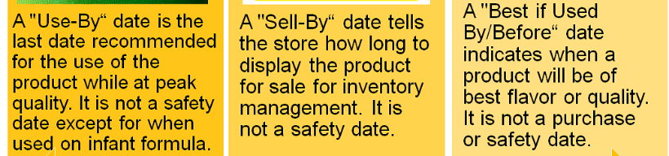
Food Label Dates
What do these labels mean to you?
What would you do if the date was already past?
As always, sensory checks are the most reliable
Albrecht (2020)

Slide 21
Progress on Food Label Dates Confusion
Two recent efforts have been made:
  H.R. 3981, referred to as the “Food Date Labeling Act of 2019
  H.R. 4987, referred to as the “Food Date Labeling Act of 2025
Would introduce only 2 labels
  BEST if use by (BB) – quality of food
  USE by (UB) – safety of food
Allowed for donations to food banks past the BEST date but before USE date
No current movement on H.R. 4987 despite widespread and bipartisan support

Slide 22
What’s in it
How the list of ingredients tells more than first appearance

Slide 23
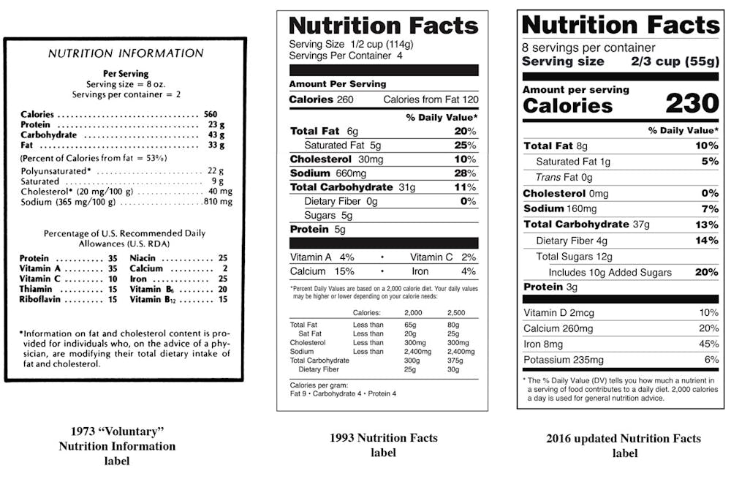
Nutritional Facts Panel Evolution
Increasing both the amount and accessibility of information
Frohlich (2024).

Slide 24
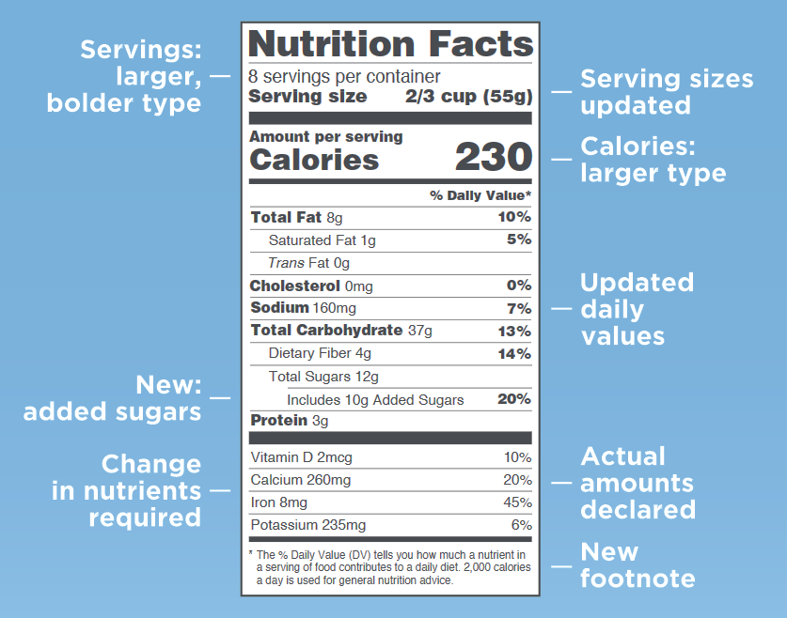
Current Nutritional Facts Panel
Several changes meant to respond to food trends
FDA (2013).

Slide 25
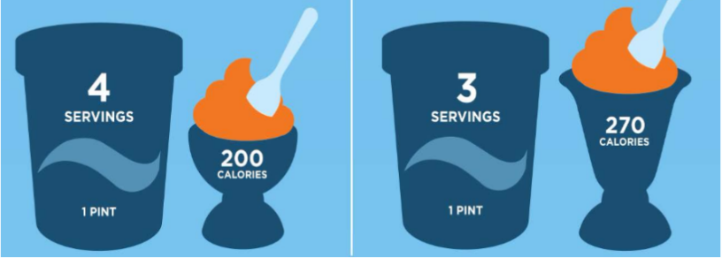
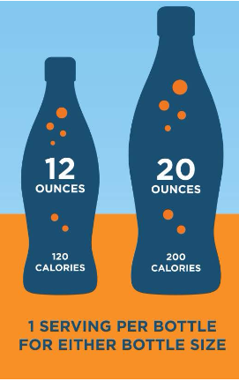
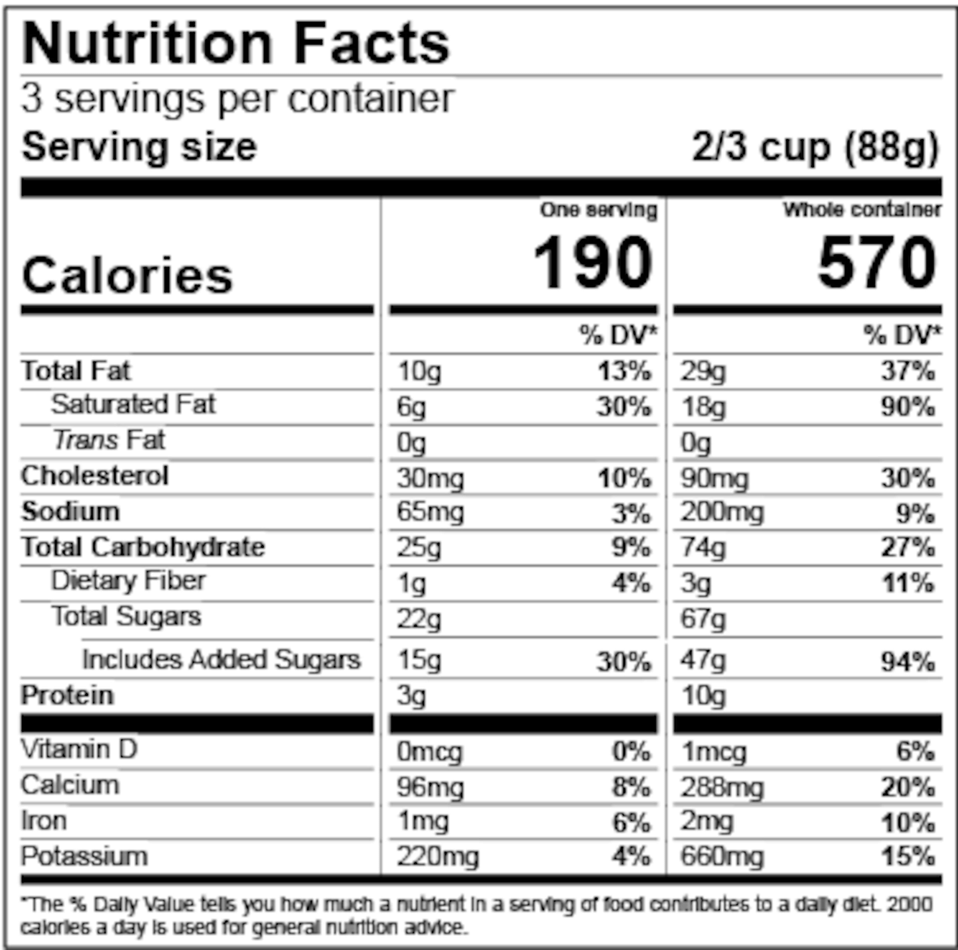
Serving size major changes
Meant to reflect actual consumption of product
Albrecht (2020)

Slide 26
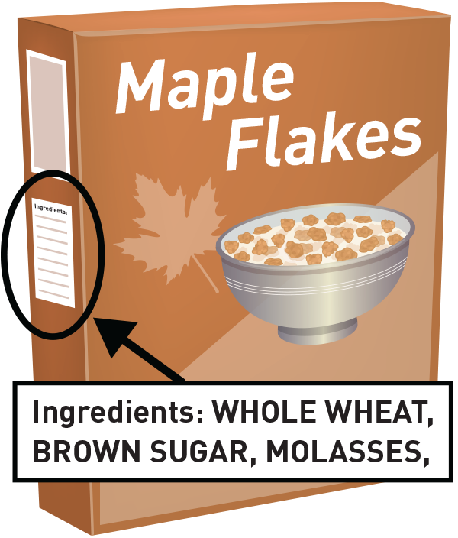
Ingredients list
Ingredients must be listed below the Nutrition Facts panel and by common name in descending order by weight
What stands out in your
collection of items?
How many times does
sugar appear?
Hint: Maltose, sucrose, glucose, high
fructose corn syrup, fructose, cane
juice, agave syrup, honey, maple syrup,
coconut nectar, dextrose are all sugar
FDA (2013).

Slide 27
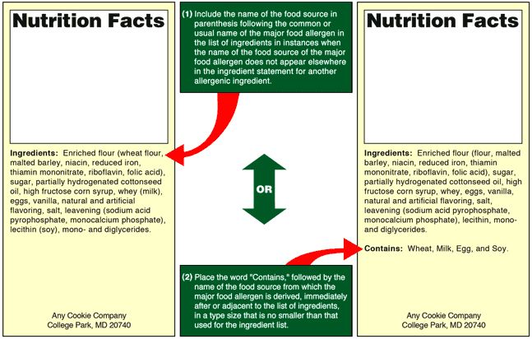
Allergens in food
Nine allergens must be identified:
  Eggs, milk, wheat, soy, peanuts, type of tree nuts, type of fish type of shellfish, sesame (newly added)
FDA (2013).

Slide 28
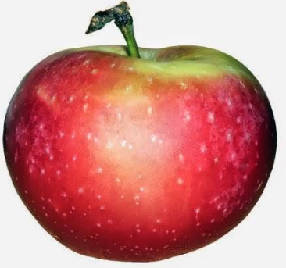
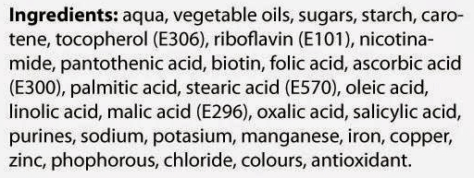
What if you cannot pronounce it?
Would you eat this product, only given the ingredient list?
The list shows each ingredient in a food by its common or usual name, which means chemical name are fine

Slide 29
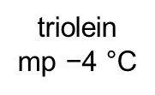
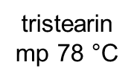
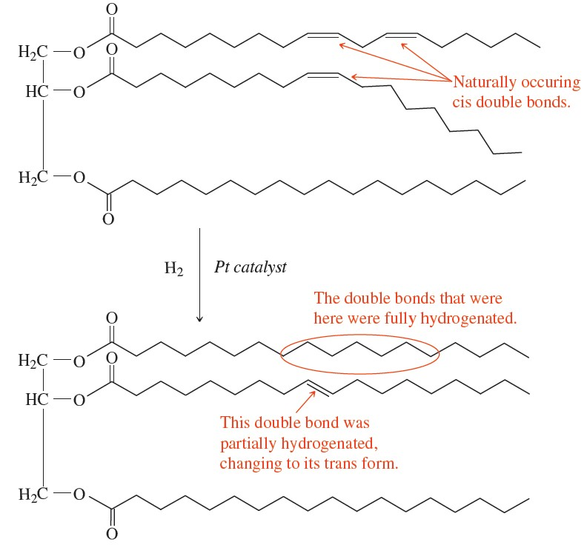
Chemistry of fats
Natural fats are often processed to make changes to their structure
Low density fat
Unsaturated (“good”) fat
Olives, fish, nuts, vegetables
Vs
High density fat
Saturated (“bad”) fat
Butter, lard, red meat, dairy

Slide 30
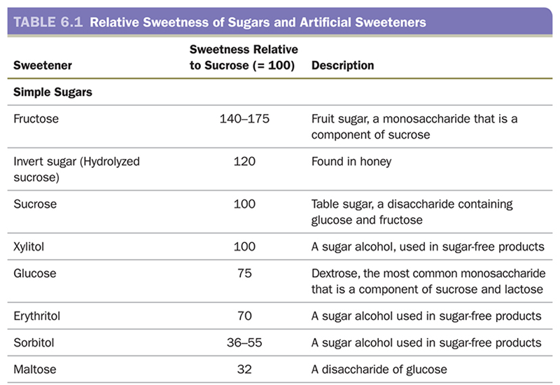
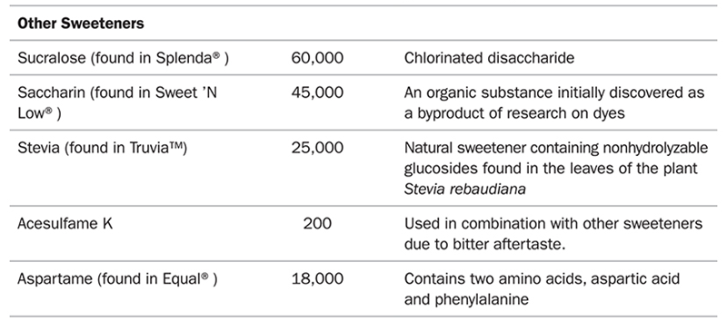
Not all sugar is the same
Compare the list of sweeteners to the right and discuss trends.
Now what happens when we compare to more synthetic sweeteners.
Frost (2020).

Slide 31
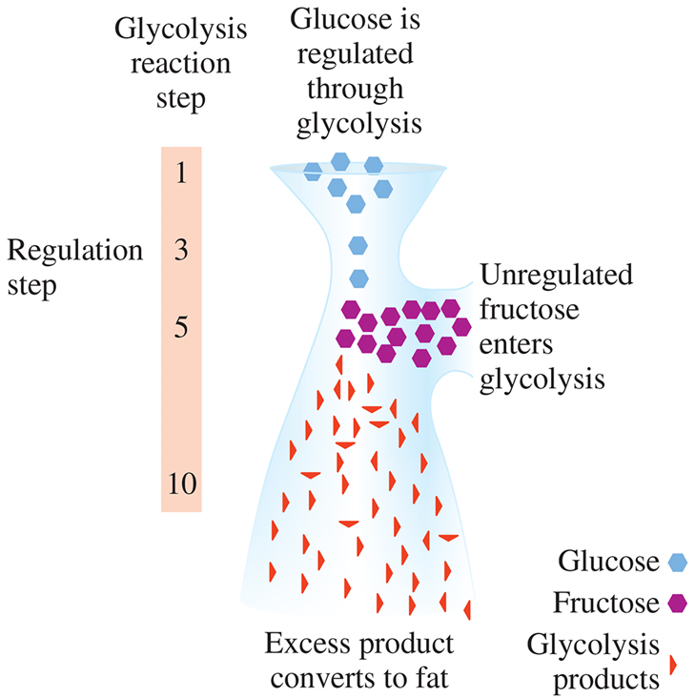
Fructose ≠ Glucose in the body
Fructose is readily taken up in the muscle and liver.
However, fructose uptake by the cells is not regulated by insulin. All fructose in the bloodstream
is forced into catabolism.
Glycolysis is regulated at step 3, but fructose enters at a later step – if not required for energy by the cells, is converted to fat.
Frost (2020).

Slide 32
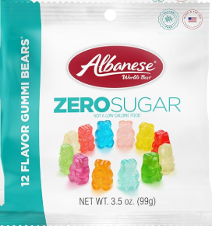
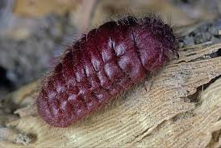
Other effects of food ingredients
“Sugar free” gummi bears
  Contain maltitol which is know to have laxative effects
  (just read some Amazon reviews)
Cochineal (also known as carmine)
  Vibrant red dye produced from insects
  Can trigger allergic reactions
Alcohol
  Due to priority in metabolizing, often gets turned into fat as not regulated by insulin
  Has 7 Calories per gram (fat has 9)

Slide 33
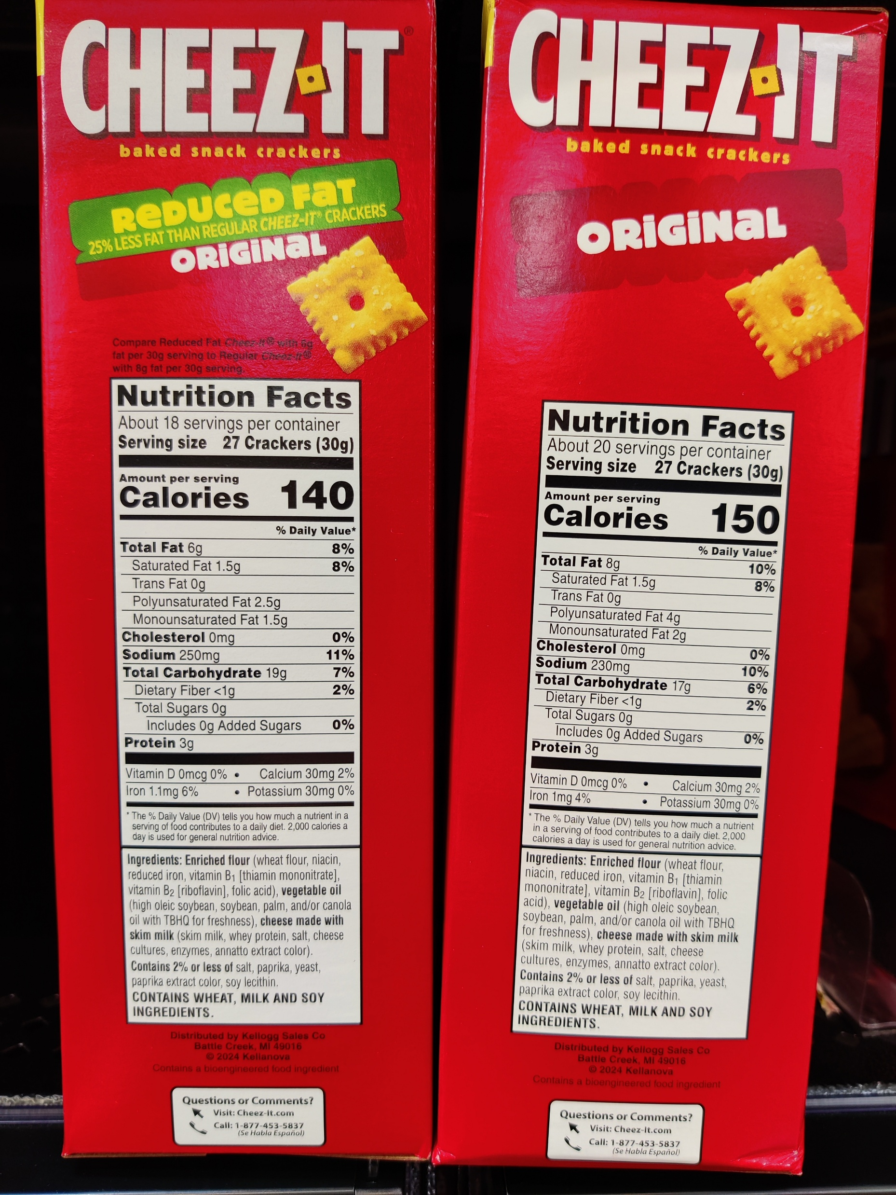
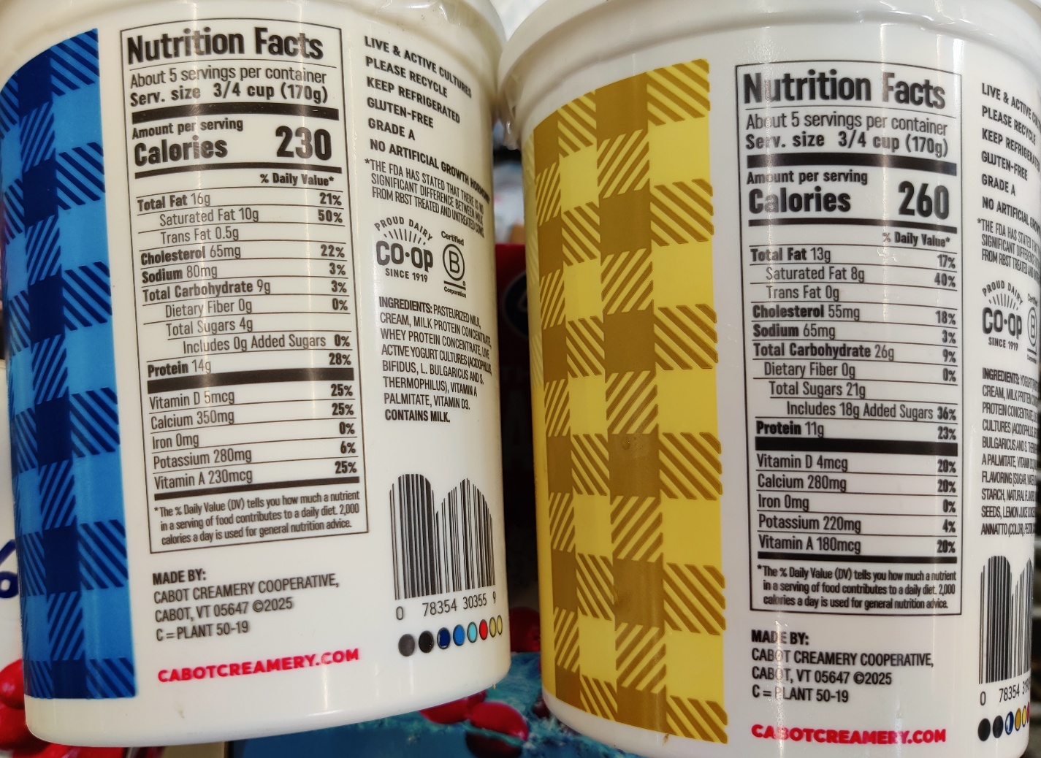
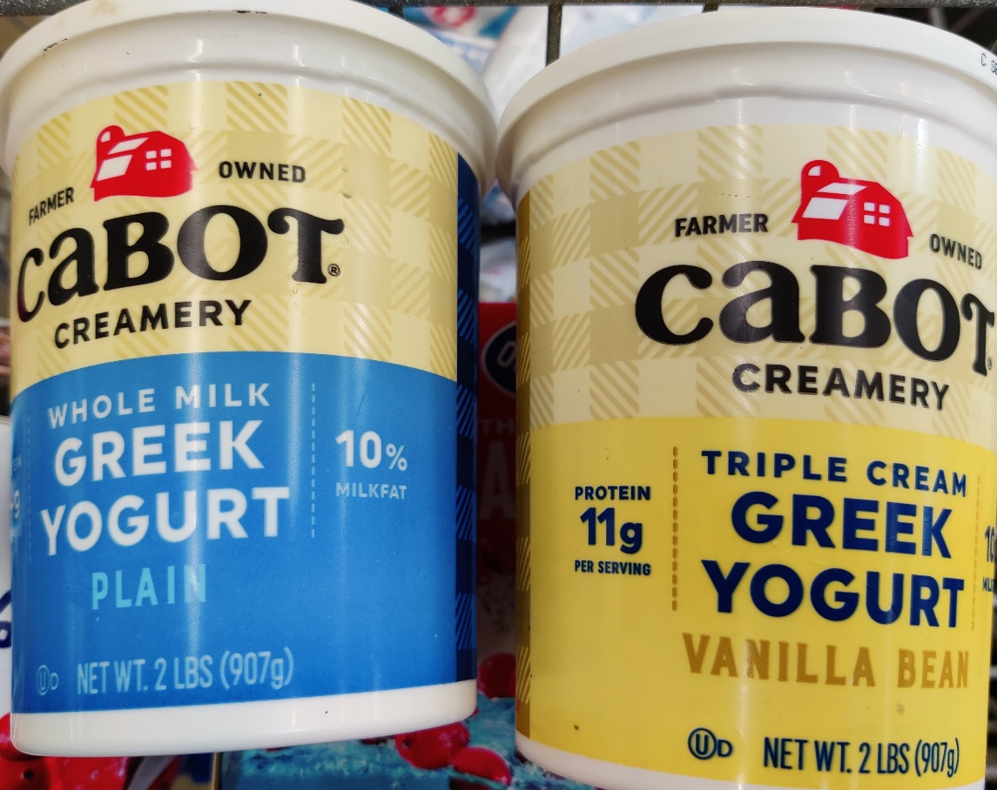
Other effects of food ingredients
Ingredient substitutions
  Lowering the fat level in food to be more “healthy” often results in increased sugar
“Healthier” options are still high
in sugar/fat
Image source: Photos by Zack Matesich

Slide 34
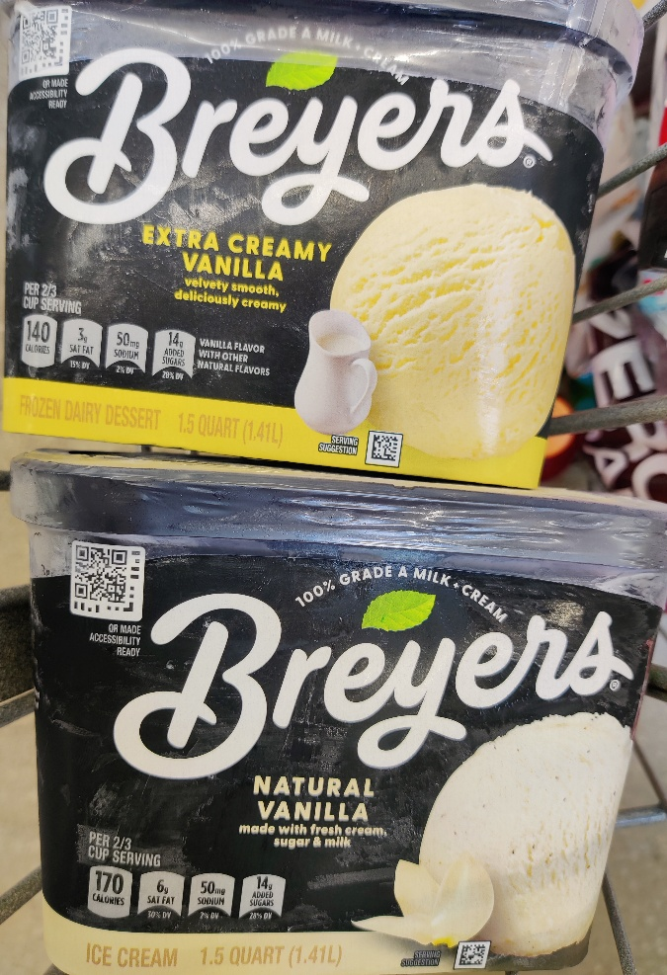
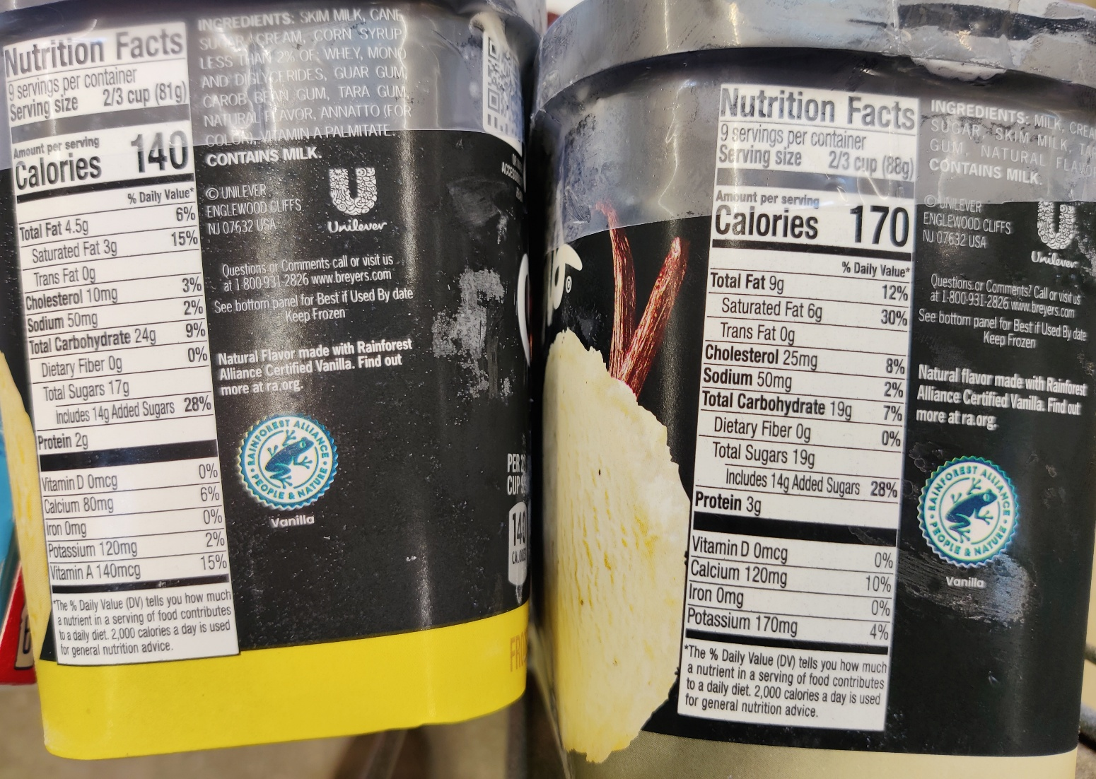
Food ingredients impacting product
Ice cream vs frozen dessert
  Based on milk/cream content
Subway bread in UK
  Classified as a confectionary due to high sugar content
  Subway was attempting to bypass a tax on sweets
Image source: Photos by Zack Matesich

Slide 35
Bringing it all together
Food labels are well regulated by the FDA with clear guidelines
Areas where progress can be made on making a more uniform approach to aid consumer
The food ingredients list has a wealth of informartion
Interactive tool to explore nutritional facts: https://www.accessdata.fda.gov/scripts/InteractiveNutritionFactsLabel/

Slide 36
References
Albrecht, J.; Schwarz, C.; Henneman, A., University of Nebraska-Lincoln Extension. What's on a Food Label, (2020) https://food.unl.edu/free-resource/whats-food-label-presentation/, 9 June 2026.
Crasto, O. History of Food Labelling, (2022) https://www.foodlabelsolutions.com/info-centre/Packaged-Foods/history-of-food-labelling/, 9 June 2026.
Frohlich, X. Nutrition Facts labels have a complicated legacy, (2024) https://theconversation.com/nutrition-facts-labels-have-a-complicated-legacy-a-historian-explains-the-science-and-politics-of-translating-food-into-information-231894/, 9 June 2026.
Frost, Laura D., and S. Todd Deal. General, Organic, and Biological Chemistry. 4th ed., Pearson, 2020.
Phelan, J (2021). What is Life? A Guide to Biology with Physiology. 5th ed. W. H. Freeman and Company
USDA. Guidance for Industry: Food Labeling Guide (2013) www.fda.gov/FoodLabelingGuide. 9 June 2026.

Slide 37


Thank you!
Any questions?
Assistant Professor
The Ohio State University
Division of Arts, Science, and Business / Ohio State ATI
328 Wooster Science Building
330-462-6216 (office)
matesich.9@osu.edu

