Slide 1
OHA Workforce Priorities: Strategic Planning & Member Support
Ohio ACTE- Health Sciences Workshop
September 24, 2026

Slide 2


03
Who WE Are
VISI N
MISSI N
OHA speaks with one unified voice for all Ohio hospitals and health systems and leads the effort in developing a high quality, sustainable system by focusing on:
  Advocacy
  Economic sustainability
  Workforce
OHA exists to collaborate with member hospitals and health systems to promote a sustainable health care system so that Ohioans have access to high quality hospital care in their communities.
VALUES
Our values define who we are, what we believe in, and how we engage with the community and one another. They guide our actions and interactions.
  Unity
  Service to members
  Continuous improvement
  Collaboration
Notes:
OHA Membership includes ALL Ohio hospitals
Diversity and potential reach of our membership- small and independent, large health systems, critical access, acute care, etc.

Slide 3

Goals & Objectives
Workforce
Support Ohio hospitals’ efforts to transform the healthcare delivery system to effectively address evolving workforce challenges.
OBJECTIVES
A. Workforce innovation
Leverage opportunities and data to assist members in transforming the future hospital workforce by identifying opportunities to expand roles and scopes of practice, highlighting strategies to reduce barriers, promoting sustainability, and sharing best practices.
B. Talent pipeline
Support member efforts to strengthen workforce supply by providing resources, engaging with other workforce partners, and advocating for policies that support workforce growth and sustainability, while promoting a favorable image of Ohio hospitals and career opportunities.
C. Resilient workforce and well-being
Assist hospitals in navigating the complexities of ensuring employee well-being, fostering resilience, and maintaining a safe workplace environment.

Slide 4
Workforce advisory committee
Established in June 2025 in response to Workforce as a strategic priority
Committee is comprised of:
  Executives
  HR leaders
  Clinical representatives
  ~20 hospitals and health systems represented with regional participation across the state

Slide 5
workforce advisory committee
Purpose
To align priority focus areas with the key objectives in the OHA Strategic Plan, to include:
  Well-being, resilience, and staff retention
  Talent pipeline, recruitment, career opportunities, and key partnerships
  Innovative workforce solutions including care delivery transformation and use of technology
The Workforce Advisory Committee will:
  Work with major stakeholders, strategic partners, higher education and government to eliminate barriers
  Develop solutions to workforce challenges
  Identify strategies to support hospital efforts to transform the health care delivery system
  Utilize data for prioritization and strategy development
  Advise on workforce policy issues, advocacy, and legislation

Slide 6
Workforce advisory committee
Committee aims:
Identifies strategies, barriers, and solutions to workforce challenges
Collaborates with and acts upon OHA Board involvement, feedback, and input
Informs decisions on:
External stakeholders to align and partner with
Data collection and analysis
Policy issues, advocacy, and legislative efforts
Strategic value to members:
Provides a forum to exchange ideas and advance progression of strategies and action plans

Slide 7


Workforce advisory committee
Member Support
Discussed and referenced at OHA Board meetings on a consistent basis
Considered a trusted source for executives seeking solutions and action plans
Workforce resources:
Designated learning track at OHA Annual Meeting
Educational webinars
Collaboration with workforce corporate partners
Cross-collaboration with OHA committees and societies
  Nursing leaders
  HR professionals
The WHY behind the work:
Notes:
Emphasize impact and expertise of our societies- benefits of participation, events, etc.

Slide 8
Workforce subcommittees
External Stakeholder & Advocacy:
Partner with local, regional, state and federal organizations to identify and advance effective strategies and models
Build local relationships to inform and influence statewide discussion and collaboration
Collect and analyze statewide data to assess capacity and vacancy trends
Identify specific clinical practice examples to support regulatory change
Assess challenges in scope of practice, regulation, and education pipeline to identify opportunities for improvement
Collaborate with regulatory bodies and academic institutions to reconcile degree requirements and job competencies

Slide 9
Workforce subcommittees
Clinical/AI Strategy:
Provide support to statewide efforts as it relates to AI and tech implementation
Establish a model AI approach and framework with intake tools, review checklists, vendor questions, and contract language for guidance and reference
Identify statewide advocacy efforts in the role of AI from a legislative perspective
Define value in inventorying AI applications with high usage, visibility, and specific categories
Share successful practices related to AI governance structure, intake process, policies, vendor review, and staff education
Narrow focus to broader governance issues rather than specific technologies
  Ohio hospitals vary in size, budget, EHR, staffing, and AI maturity
Request for OHA:
To provide templates, shared guidance, and a forum for shared ideas.

Slide 10
Workforce
Connections & Conversations
OACC (Ohio Association of Community Colleges)
  Senior Director of Workforce Partnerships
  Chief Academic Officer
  Director of Institutional Effectiveness
ODJFS
  Deputy Director and Assistant Deputy Director
Ohio Department of Education and Workforce
  Deputy Director for Division of Career-Tech Education and Workforce Readiness
  Office of Graduate Success
Ohio State University
ASPYR- HCCOCO (Healthcare Career Collaborative of Central Ohio)
Ohio ACTE
Ohio Department of Higher Education
AHA Workforce Community (SHA’s, shared forum, conferences)

Slide 11
Ohio Data – 2036 Projections

Slide 12
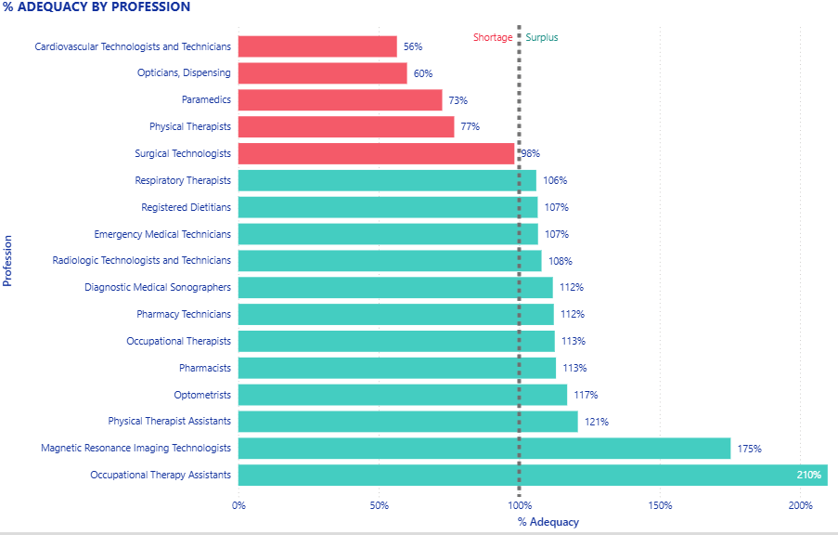
Adequacy – Allied Health
Workforce Projections –2036
Notes:
Priority healthcare occupations for this group:
Nursing
Surgical techs
Rad techs/Imaging
Resp. Therapy
MA
Med lab techs
**These top 6 are aligned across the state as priority occupations

Slide 13
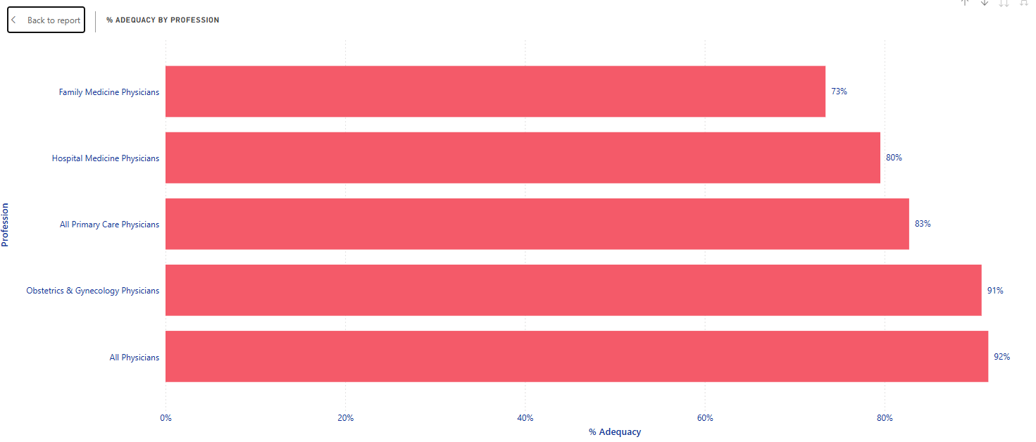
Physicians
Workforce Projections - 2036
Family Medicine
-1,410 FTE
Hospital Medicine
-360 FTE
All Primary Care
-2,070 FTE
OBGYN Medicine
-170 FTE
ALL PHYSICIANS
TOTAL -3,620 FTE
Notes:
For slides 13 & 14- discrepancy predicted in physician FTEs versus nursing
Two different things being shown:
-% adequacy is represented by the red/green bars and their length
-Actual FTEs are represented there

Slide 14
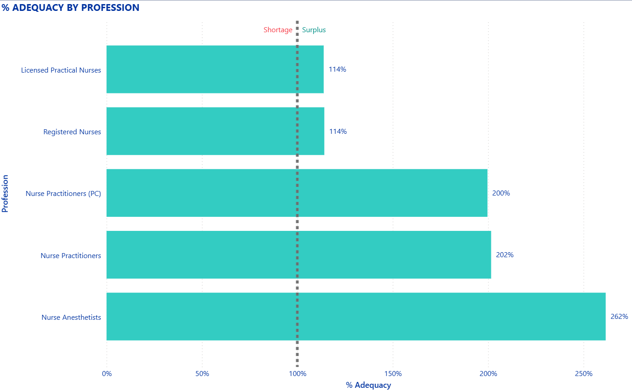
Nursing
Workforce Projections - 2036
44,370 Nursing FTE
4100 FTE
17950 FTE
3030 FTE
15330 FTE
3960 FTE
Notes:
For slides 13 & 14- discrepancy predicted in physician FTEs versus nursing
Two different things being shown:
-% adequacy is represented by the red/green bars and their length
-Actual FTEs are represented there
-An example, on the nursing side- RNs have a smaller %, but the total number of FTE’s represented is high (114% versus 17, 950 FTE)

Slide 15
Kelsey Brown, BSN, RN
Ryan Everett, MPH
Associate Vice President, Strategic Programs
Director, Health Strategy
Kelsey.Brown@ohiohospitals.org
Ryan.Everett@ohiohospitals.org

